Slide 1
Data Structures and Algorithms Tutorial 5 – Binary Search Trees
Dr. Kok Hoe WONG

Slide 2
Topics
Tree
Binary Search Tree (BST)

Slide 3
Tree
Trees: hierarchical data structures.
Why Trees?
Store information that naturally forms a hierarchy. Such as: file system.
Trees provide moderate access/search
Trees provide moderate insertion/deletion
No upper limit on number of nodes
…

Slide 4
Main applications of trees include:
Manipulate hierarchical data.
Make information easy to search.
Manipulate sorted lists of data.
As a workflow for compositing digital images for visual effects.
Router algorithms
Form of a multi-stage decision-making

Slide 5
Binary Search Tree (BST)
A binary tree is a recursive data structure where each node can have 2 children at most.
Binary Search Tree, is a node-based binary tree data structure which has the following properties:
The left subtree of a node contains only nodes with keys lesser than the node’s key.
The right subtree of a node contains only nodes with keys greater than the node’s key.
The left and right subtree each must also be a binary search tree. There must be no duplicate nodes.

Slide 6
Code example
Tree node: IntBTNode.java
Binary search tree: IntBST.java

Slide 7
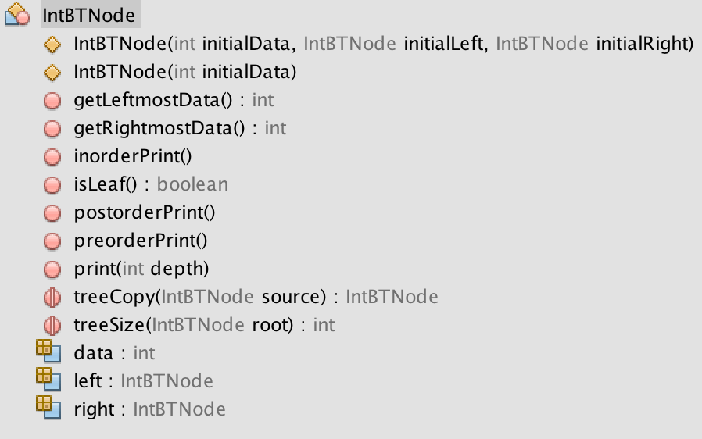
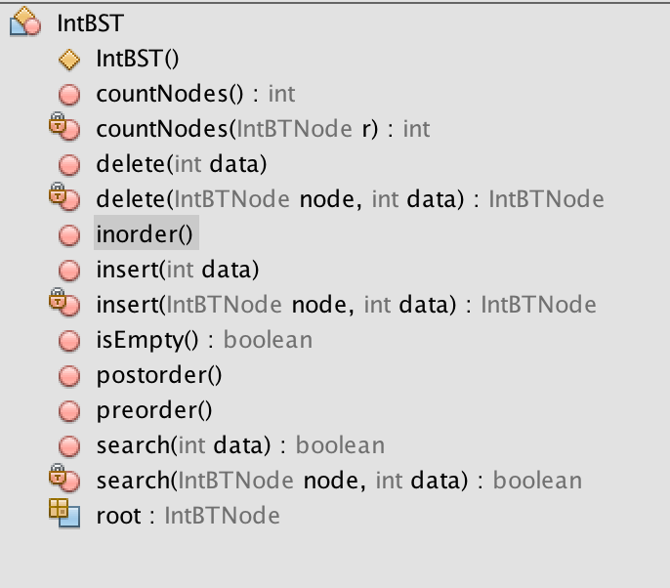
Code example

Slide 8
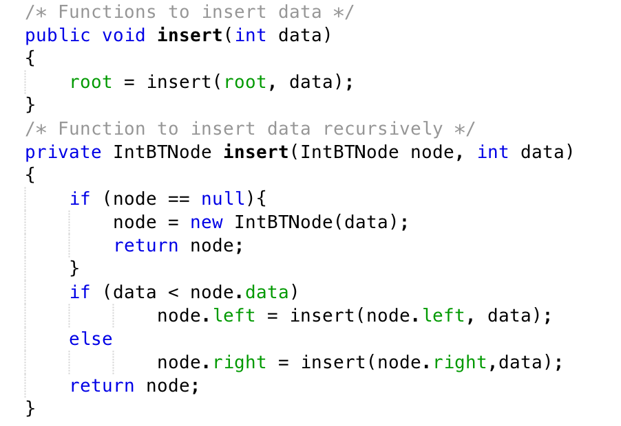
Binary Search Tree
Insertion
Insert as a leaf
Never re-arrange existing nodes
Left smaller
Right greater

Slide 9
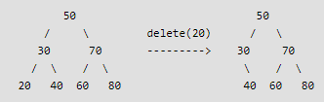
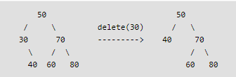
Homework
Deletion(3 cases)
A node with no child – leaf node : simply remove it from the tree. we just need to replace this node with null in its parent node
With one child : Copy the child to the node and delete the child. In the parent node, we replace this node with its only child.

Slide 10
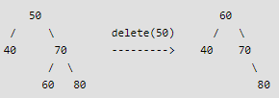
Continued.
With two child : requires a tree reorganization.
Find the smallest node (successor) from the right sub-tree.
Copy contents of the smallest value to the node and delete it.
Note that predecessor can also be used.
How to find the successor/predecessor?
Search
Logic is similar to insertion

Slide 11
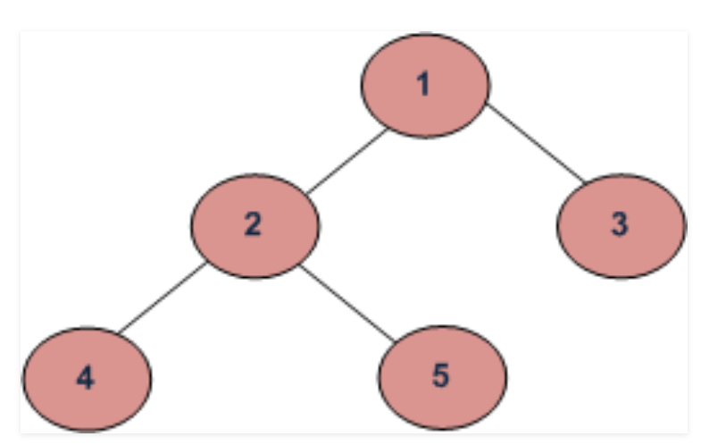
Tree Traversals
Depth First Traversals: (a) In-order (Left, Root, Right) : 4 2 5 1 3 (b) Pre-order (Root, Left, Right) : 1 2 4 5 3 (c) Post-order (Left, Right, Root) : 4 5 2 3 1 Breadth First or Level Order Traversal : 1 2 3 4 5

Slide 12
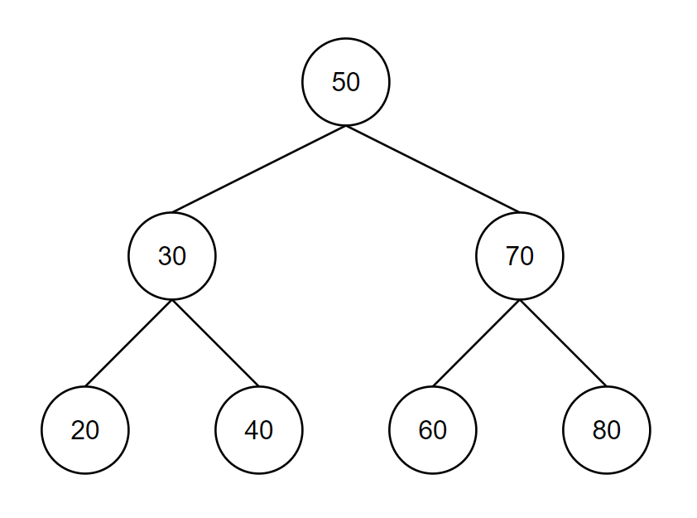
Tree Traversals
Depth First Traversals: (a) Post-order (Left, Right, Root) : 20 40 30 60 80 70 50
(b) Pre-order (Root, Left, Right) : 50 30 20 40 70 60 80 (c) In-order (Left, Root, Right) : 20 30 40 50 60 70 80 Breadth First or Level Order Traversal : 50 30 70 20 40 60 80

